Slide 1

TOP Hit Prediction
Applied data science
Burcin Aksel, Nico Hetzel, Leo Pauling, Sven weiß

Slide 2


Slide 3
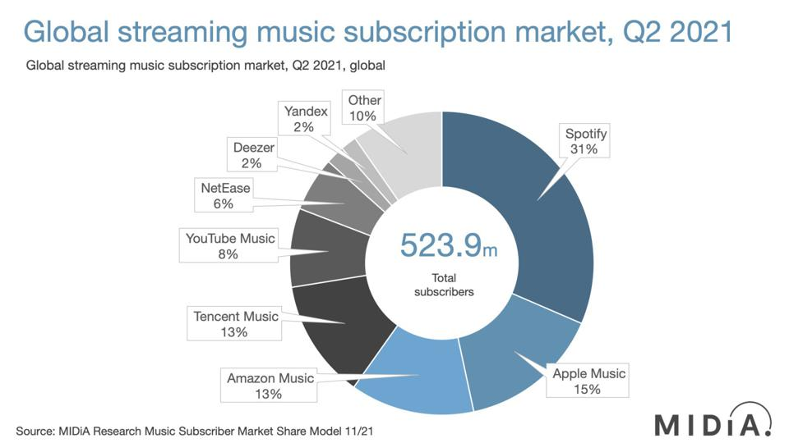
Notes:
Source: Forbes
https://www.forbes.com/sites/eamonnforde/2022/01/19/spotify-comfortably-remains-the-biggest-streaming-service-despite-its-market-share-being-eaten-into/?sh=6f71a5134743

Slide 4
SCOPE

Slide 5
SCOPE
Background: Traditionally the music industry has relied on gut feelings and intuition to identify potential hits, but now data science techniques can be used to analyze song features and predict which songs are most likely to become popular/top hit.
Objectives: By analyzing the song features such as tempo, danceability, energy, and others, we aim to understand the characteristics that make a song popular. This information can be useful for music streaming platforms, record labels, and artists to make informed decisions about their music releases and marketing strategies.
Model evaluation: We will compare different models regarding accuracy, precision, recall.
Identify Possible top hits based on song features

Slide 6
SCOPE
Data sources: we used four Spotify datasets provided by Kaggle. The datasets are:
3 data sets of the “Spotify Dataset 1921-2020, 600k+ Tracks”
artists.csv → Artist features like Popularity, Followers etc.
dict_artists.json → The artists recommended for fans of artists.
tracks.csv → The audio features of tracks.
1 data set of “Spotify tracks chart dataset (2014-2022)”
charts.csv → This dataset is comprised of weekly Spotify track chart data from 2014 to 2022. Used to get the chart position of the song in various countries.
Identify Possible top hits based on song features

Slide 7
Variable list
NAME | Description
Popularity | Measurement: Derived from absolute & recent number of streams
Energy | Liveliness of the song
Loudness | Derived from decibel measurements of the song
Liveness | Degree to which the song sounds like it was record live vs. studio produced
Danceability | Measurement of how easy it is to dance to the song
Speechiness | Measurement of words spoken
Instrumentalness | Measurement of instrumental sounds within the song
Valence | Measurement of the positivity of the song
Acousticness | Confidence whether a song is acoustic
Mode | Indication of modality (major or minor)
Excplicit | Indication whether the song contains swear words (yes or no)
Key | Standard pitch class notation (C to H)

Slide 8
Domain Exploration

Slide 9

Domain Exploration – Hit Song Science
Area first defined by Mike McCready in 2002 (CEO of Polyphonic)
Goal/Business Model:
Evaluate Hits before they are released
Identify & match musical preferences of certain groups
Original Procedure: Analyze mathematical structure of rhythm, changes in key & melodic pattern
Notes:
Brief literature review about domain and previous data science projects in this domain
Sources:
Ruth Dhanaraj; Beth Logan (2005) „AUTOMATIC PREDICTION OF HIT SONGS”
Internet → Web Archive 2005:
https://hitsongscience.com/
http://www.polyphonichmi.com/about_us.php

Slide 10
Domain Exploration – Previous Data Science Projects
Goals | Input | Features | Methods | Result
Predict Song Popularity (>90%) | Spotify Developer Application Programming Interface | Explicitness, Instrumentals, Danceability | KNN, Random Forest, Gradient Boosted Trees, Logistic Regr. | Max. 72% Accuracy
Predict Hit in Billboard Hot 100 | Million Song Data Set (MSD), Spotify API (Extra) | All API Features & Artist Score (Custom) & Release Time | EM, LR, GDA, SVM, DT and NN (RF) | 69 – 77% Accuracy (81 – 89% Accuracy)
Determine Variation of Attributes to Streams | Spotify API (Custom Python Code) | Genre (SF) & All API Features | Correlation Analysis, Linear Regression | Low Explanatory Power
Determine Variation of Attributes to Popularity | Spotify WEB API (Custom Code) ONE Artist | All API Features | Beta regression model, GLMM, Beta GLMM | Mixed Explanatory Power (some pos, some neg, rest irrelev)
Determine Features of Successful Playlists | Spotify & Surveys |  | Plotting | Intimacy, Focus & Variety
Characterize Trendy Music Clusters | Spotify API | All API Features | KNN | Variety of Size & Attributes
Notes:
Sources:
L1: Dawson, Christopher E. Jr.; Mann, Steve; Roske, Edward; and Vasseur, Gauthier (2021) "Spotify: You have a Hit!," SMU Data Science Review: Vol. 5: No. 3, Article 9.
L2: Georgieva, Elena; Suta Marcella; Burton, Nicholas: “HITPREDICT: PREDICTING HIT SONGS USING SPOTIFY DATA” (2018)
L2,5: Middlebrook, Kai; Sheik, Kian: „SONG HIT PREDICTION: PREDICTING BILLBOARD HITS USING SPOTIFY DATA “ (2019)
L3: Nijkamp, Rutger “Prediction of product success: explaining song popularity by audio features from Spotify data” (2018)
L4: Spera, Carola; Sciandra, Marangela “A Model Based Approach to Spotify Data Analysis: A Beta GLMM” (2020)
L5: George John Jordan Thomas Aquinas Hayward „What makes a playlist succesful? “ (https://ghayward.github.io/assets/files/Data_Scientist_Presentation_George_JJTA_Hayward.pdf)
L6: http://www.na-businesspress.com/JMDC/JMDC14-3/8_Al-BeitawiFinal.pdf
Abkürzungen:
Expectation Maximization (EM), Logistic Regression (LR), Gaussian Discriminant Analysis (GDA), Support Vector Machines (SVM), Decision Trees (DT), and Neural Networks (NN)
Random Forest (RF)
Generalized Linear Mixed Models (GLMM)
All API Features:
Danceability, Energy, Speechiness, Acousticness, Instrumentalness, Liveness, Valence, Loudness, and Tempo
Duration, Mode

Slide 11

Domain Exploration – Results
Hit Song Science is a is a field in the Data Science area, which is of great economic & academic interest
Spotify API is the best public available feature data base, providing multiple seemingly independent characteristics
Limitations / Bias due to usage of Spotify API as main source
Primarily consists of measurable song Information; e.g. no genres
Spotify provides no in depth details of feature calculation
Most researches excludes soft factors
Possible enrichment of the data with corresponding data
Main metric of the projects was "Accuracy" – " Precision" & "Recall" were mostly considered only secondarily, if at all

Slide 12
Data Exploration

Slide 13
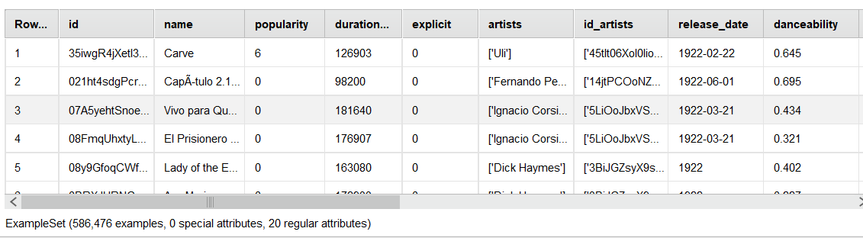
Tracks Data

Slide 14
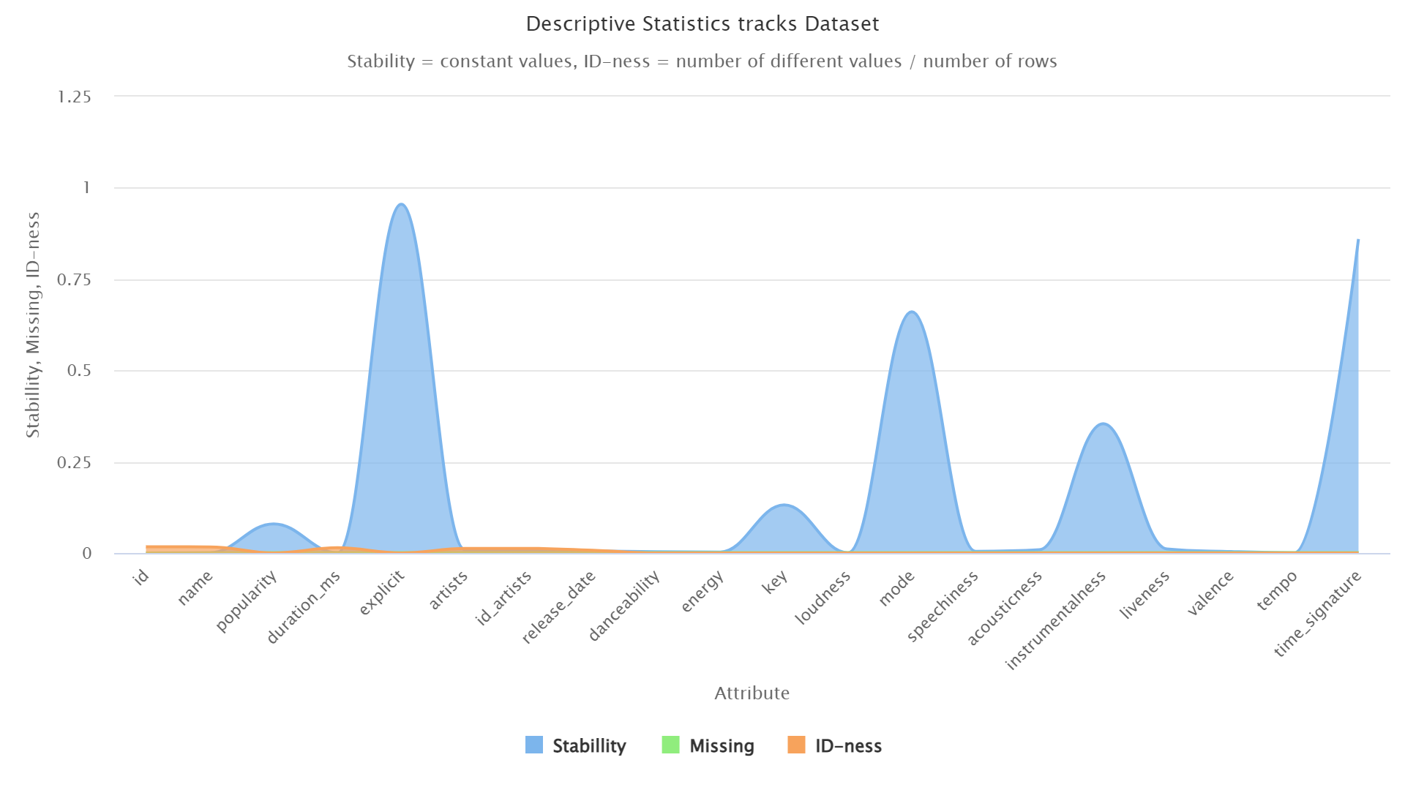
ARTISTS Data

Slide 15
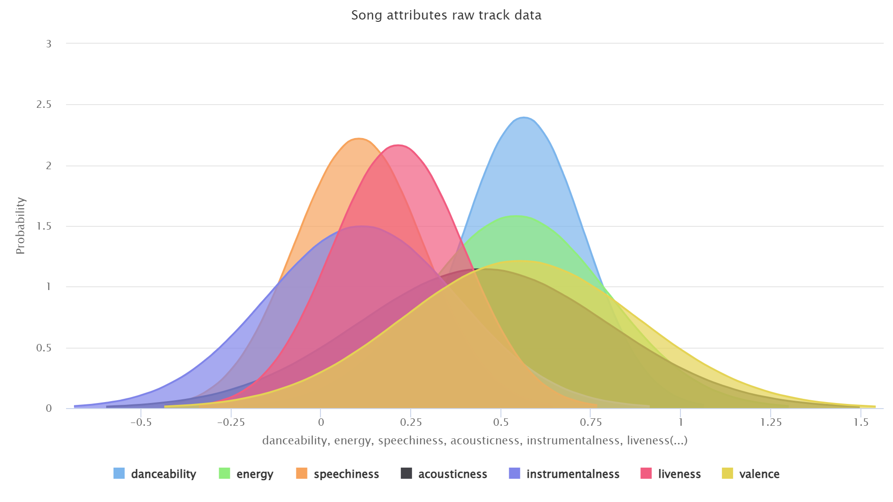
Tracks Data

Slide 16
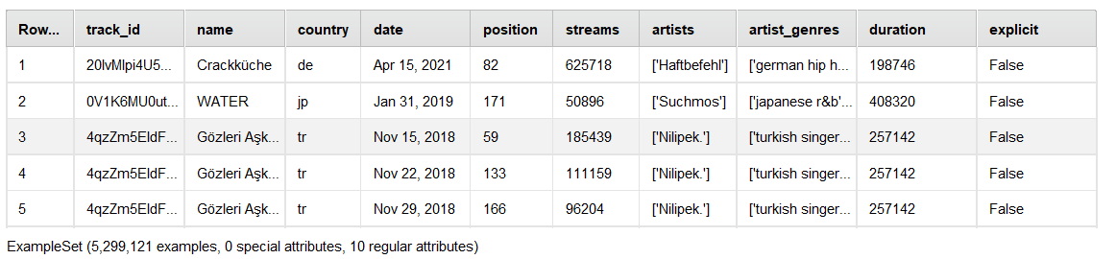
cHARTS Data

Slide 17
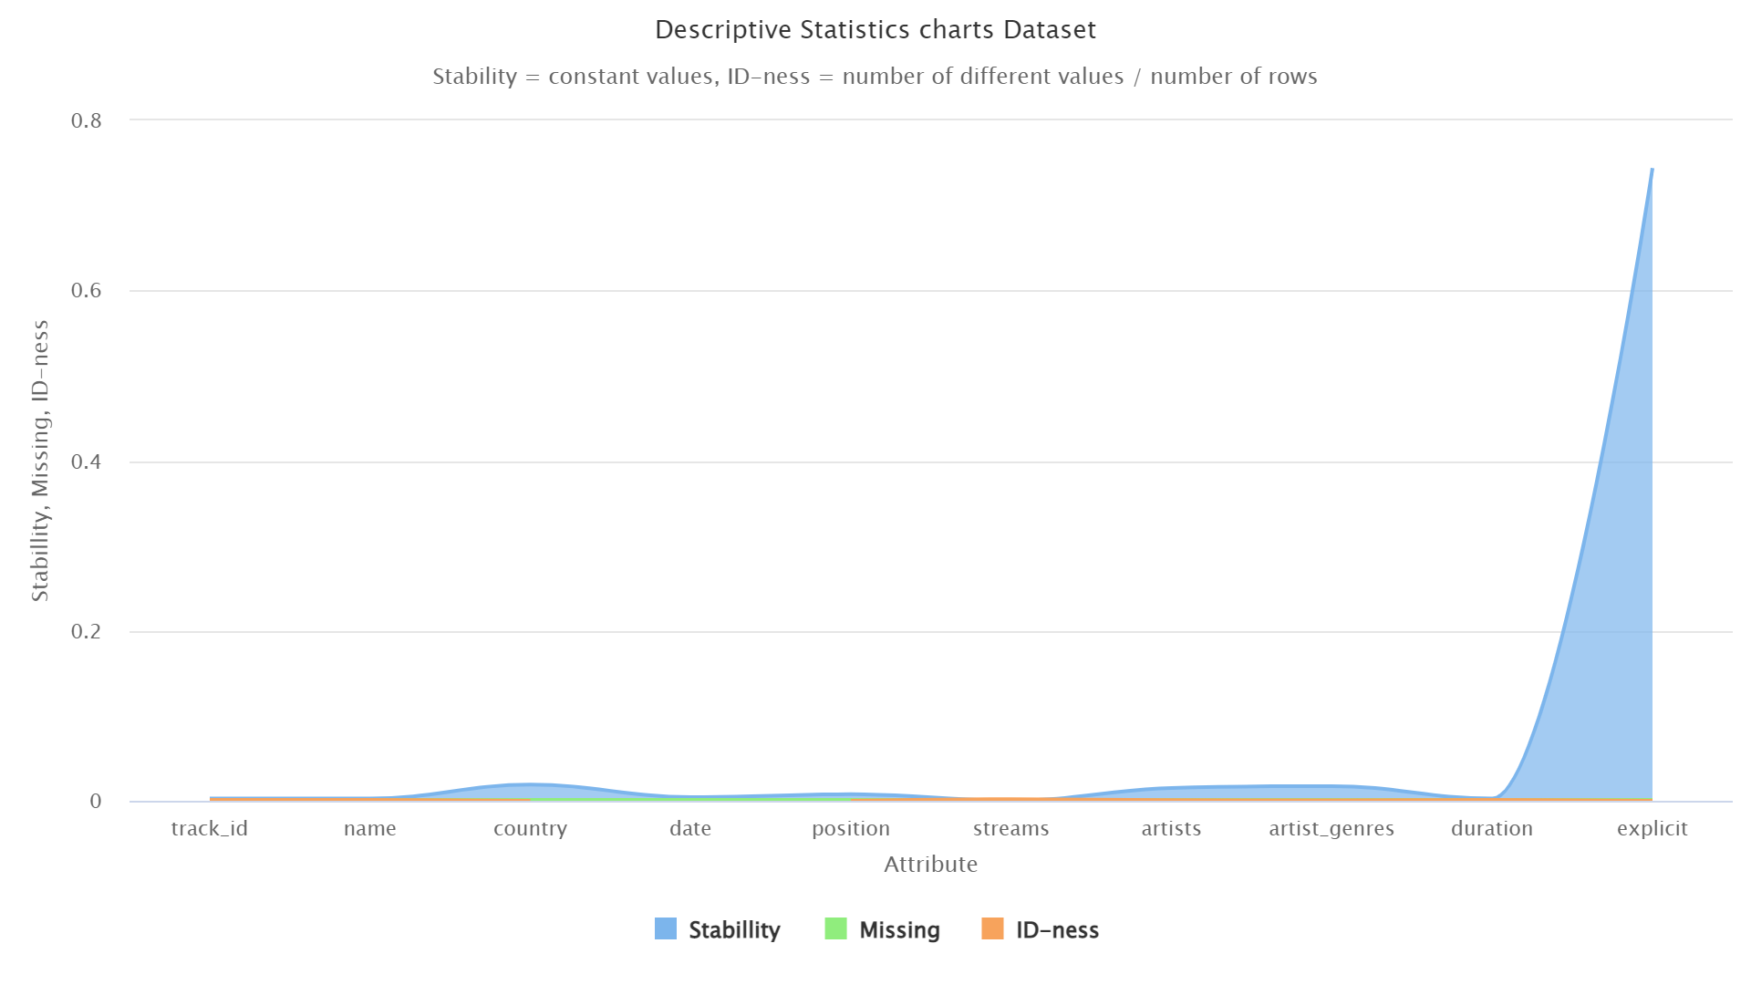
ARTISTS Data

Slide 18
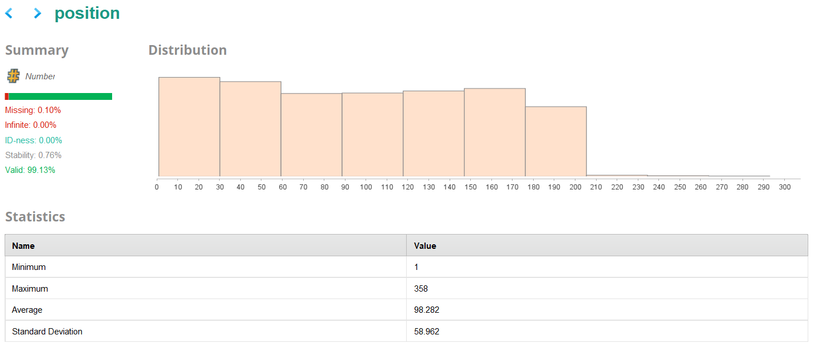
ARTISTS Data

Slide 19
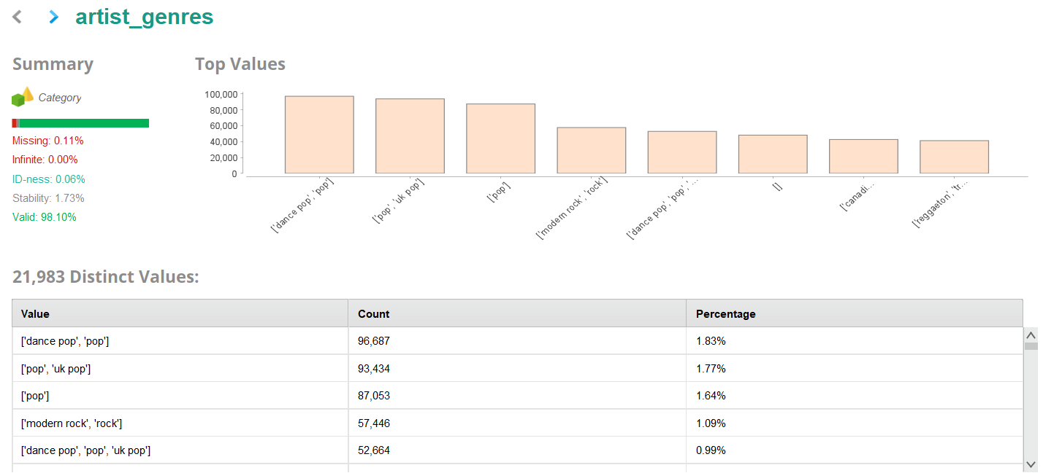
ARTISTS Data

Slide 20
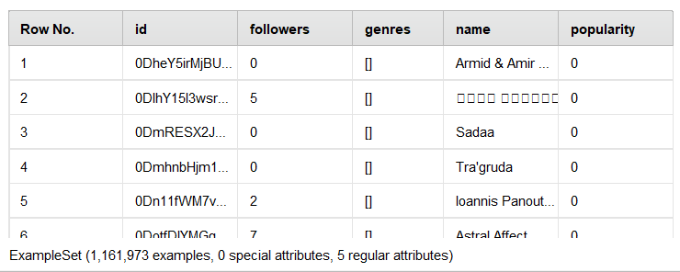
ARTISTS Data

Slide 21
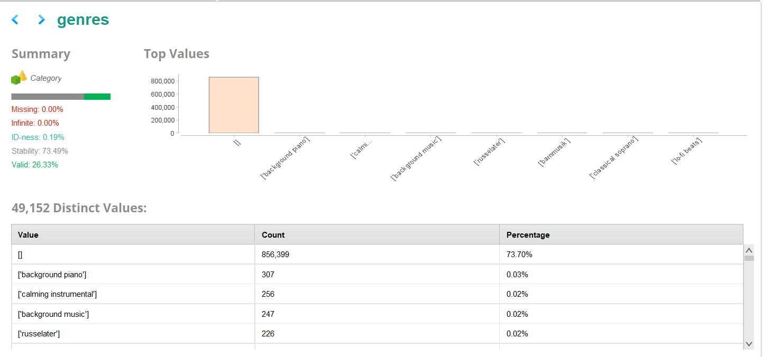
ARTISTS Data

Slide 22
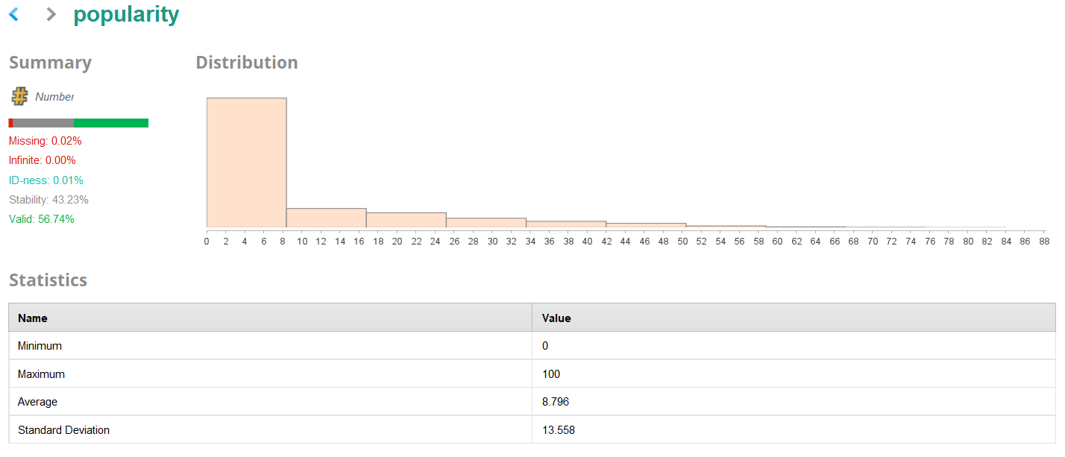
ARTISTS Data

Slide 23
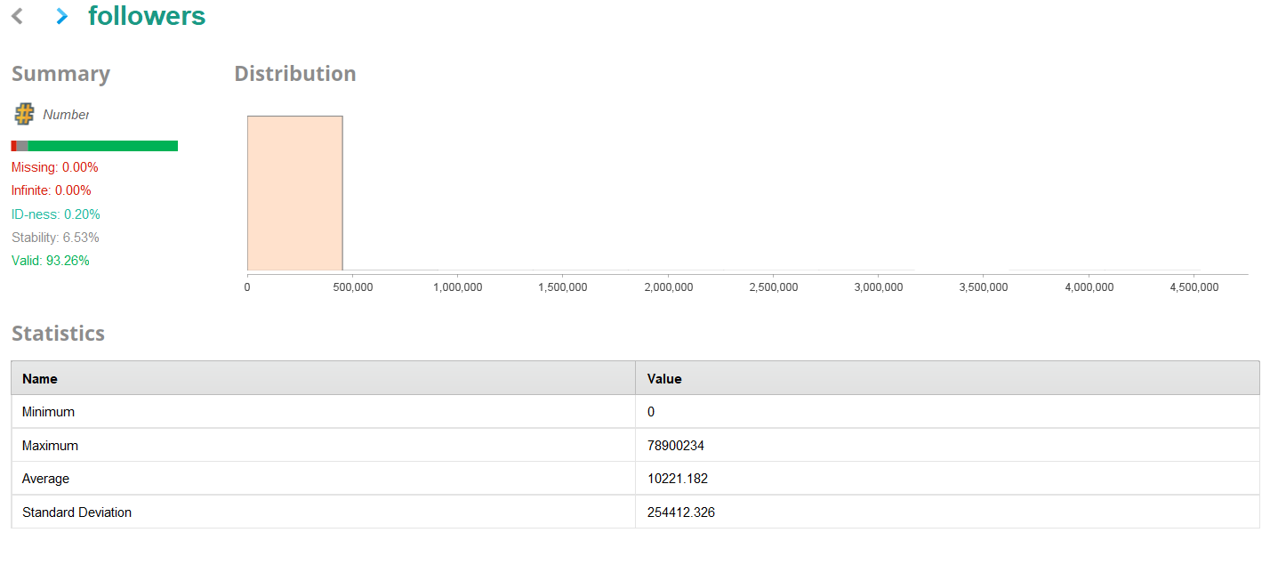
ARTISTS Data

Slide 24
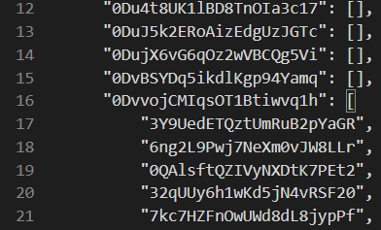
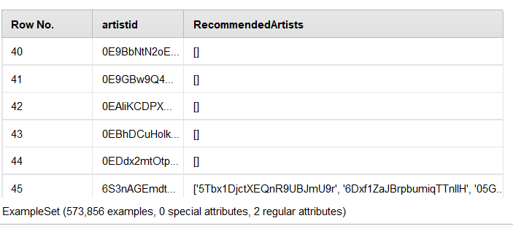
Recommended Artists Data

Slide 25
Data Exploration Insights
Some data points are missing (genres in artist dataset) – fix through joining and data engineering
Either popularity or chartsposition could work for generating a top song label (feature engineering)
Distributions are right skewed and should be normalized

Slide 26
Data Engineering
CRISP-DM process to gain 2 main datasets:
“Fin Table” Dataset – track IDs, popularity, charts position and specific musical features calculated by Spotify. Created by joining track and charts datasets from Kaggle in SQL (size issue with RapidMiner).
Cleanset Dataset – training data for modeling to see which features impact a “Top Song” in which way
“Top Song” label needs to be defined:
Top song by popularity – track popularity ≥85 (out of 100) = Top Song
Top song by charts position – lowest charts position of a track ≤30 = Top Song. (We disregard different countries for our evaluation and aggregate on the lowest / highest measure for all countries)

Slide 27
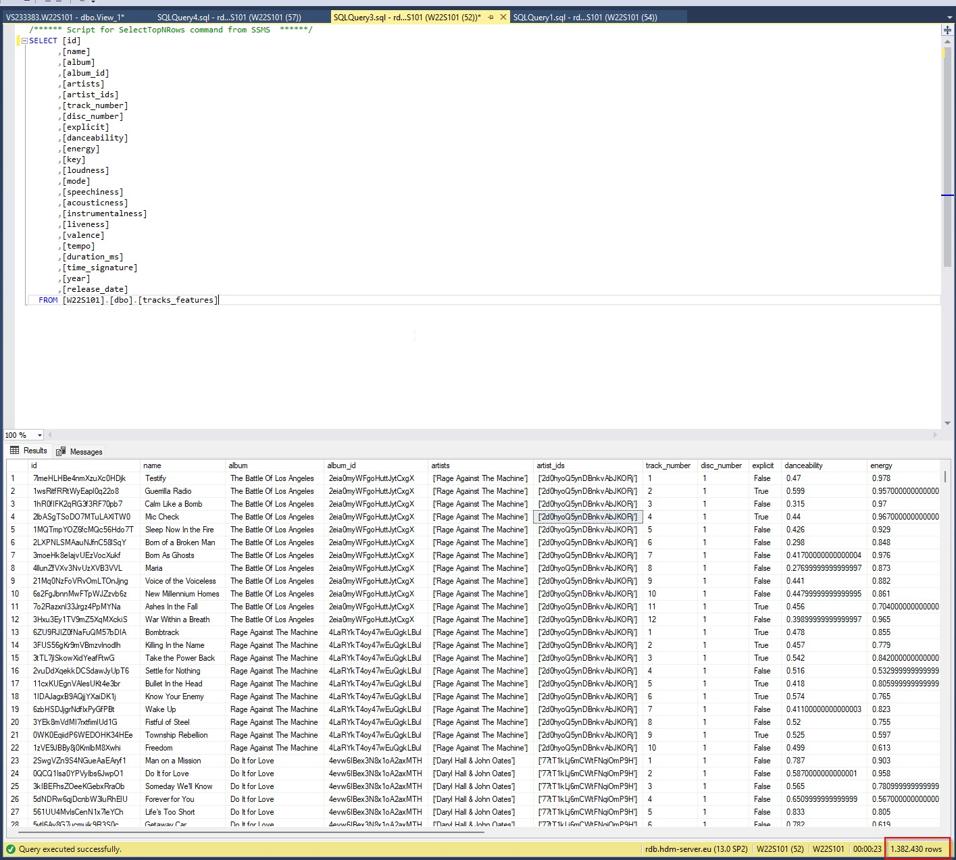
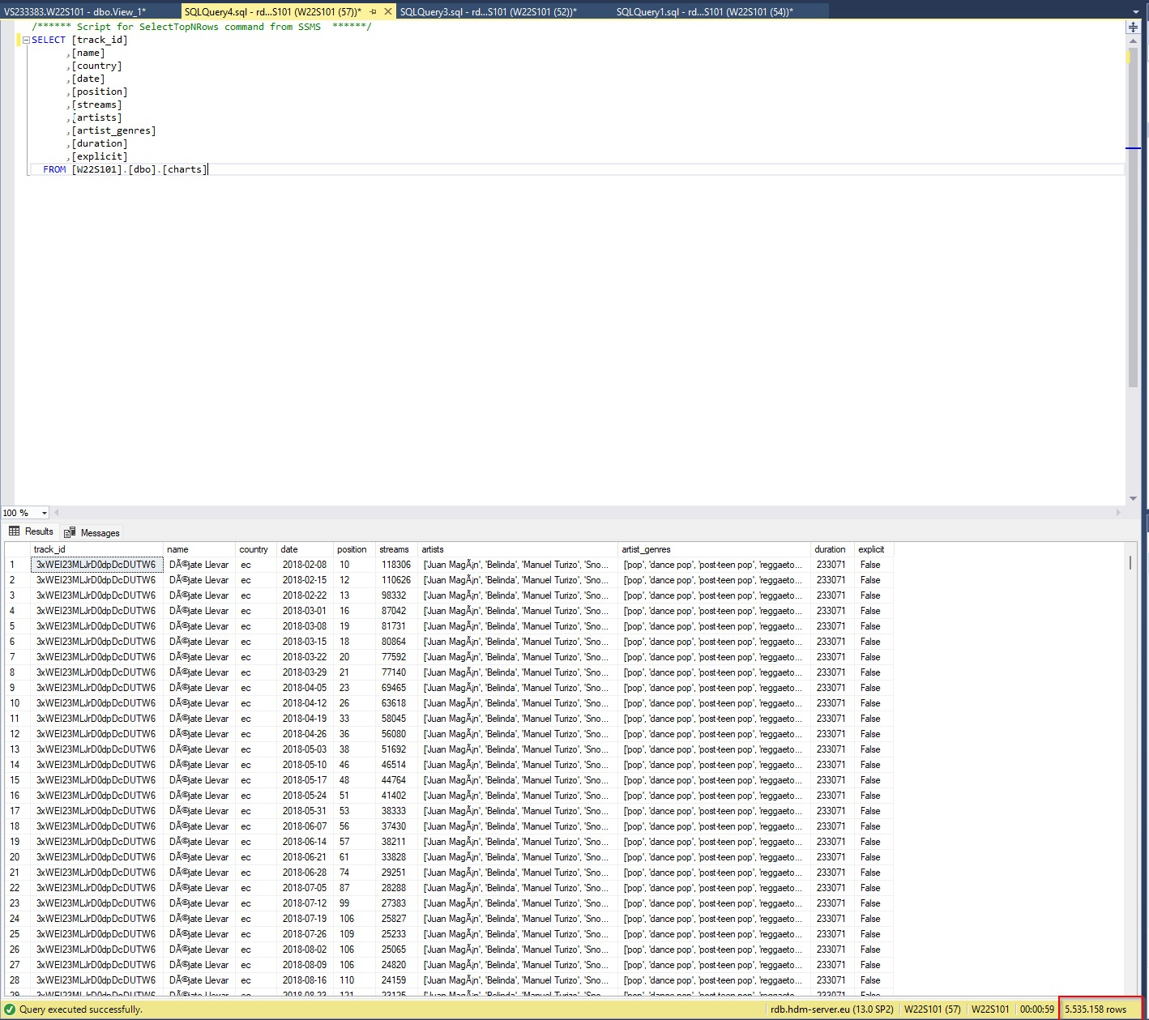
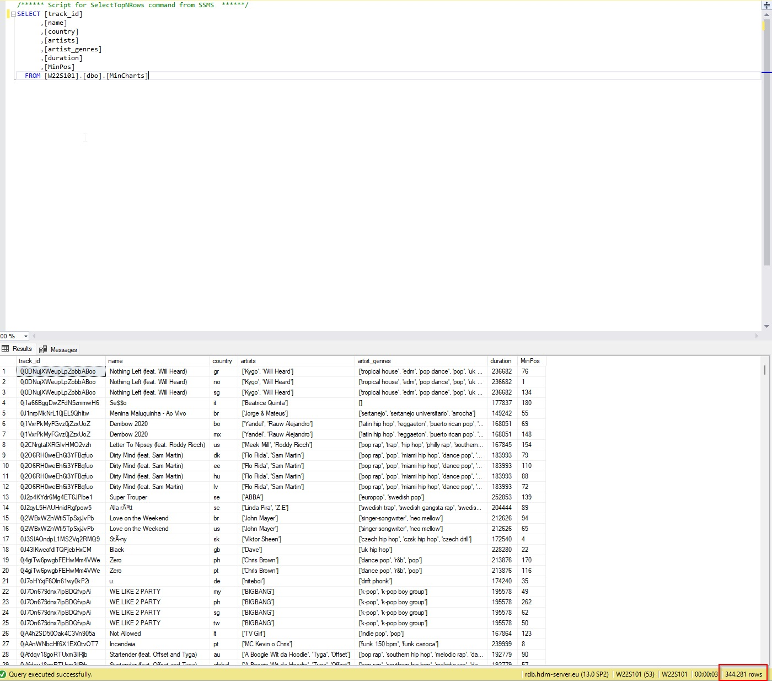
Create Fin Table
Load Data in SQL
Aggregate min(ChartsPos)
Reduce 5 Mio. to 344281 Rows with 26k unique IDs
Join Charts with Track dataset to generate Fin Table

Slide 28
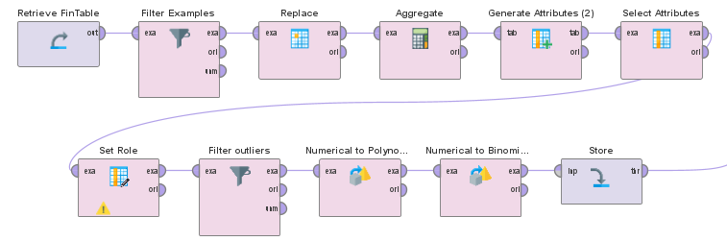
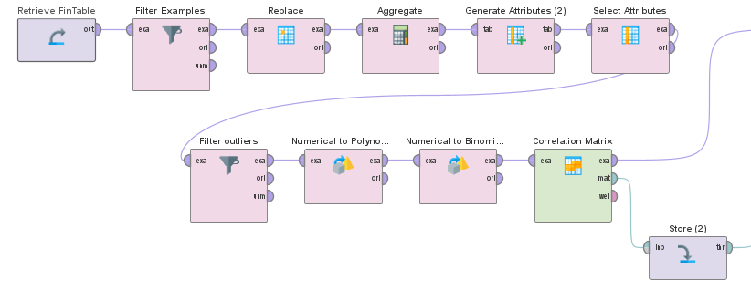
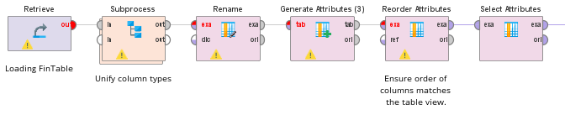
Data preparation
Inspected Dataset for missing and wrong values to replace
Filtered outliers
Created Top Song label by popularity and by min(chartsPos) to compare

Slide 29
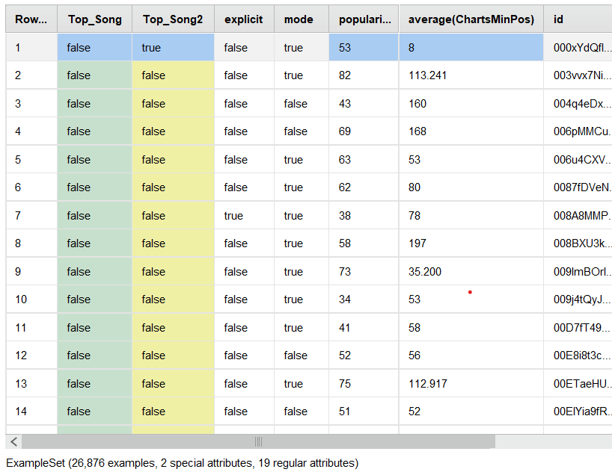
Additional Exploration on Fin Table

Slide 30
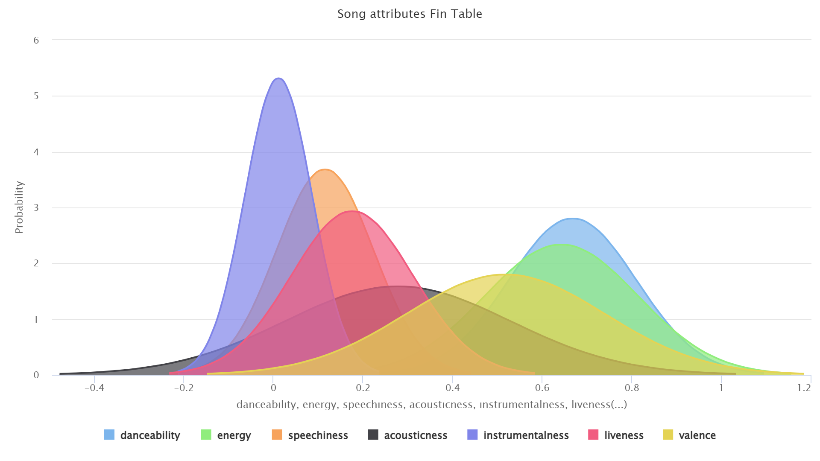
Tracks Data

Slide 31
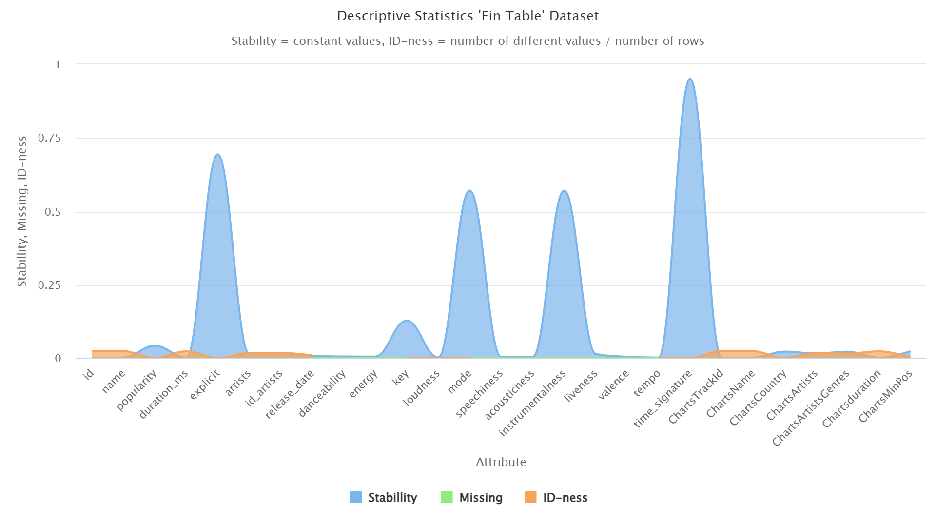
ARTISTS Data

Slide 32
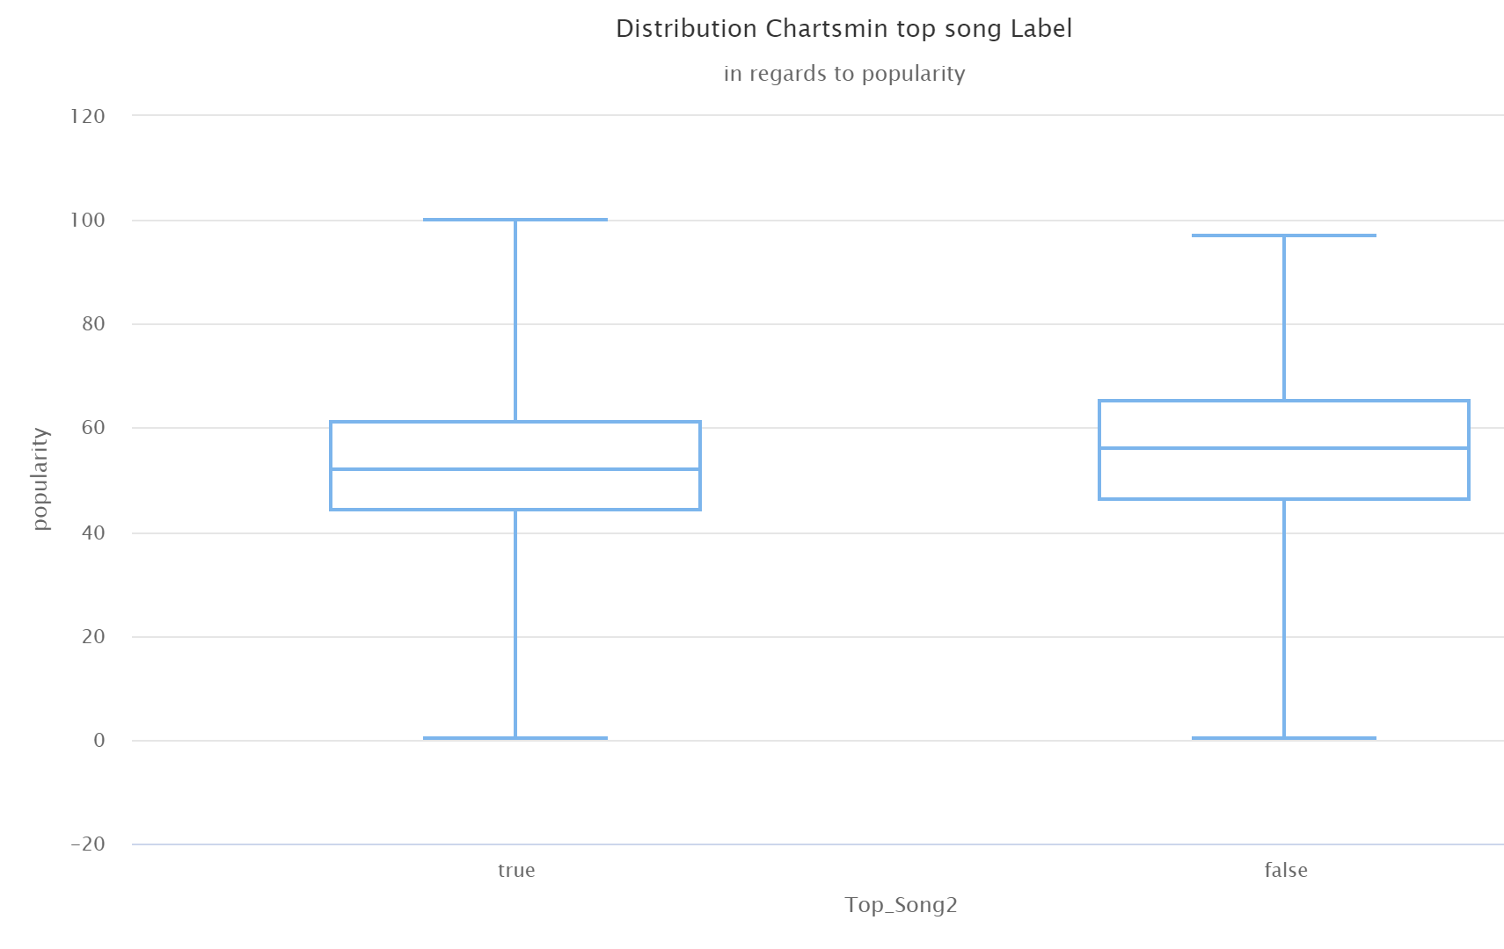
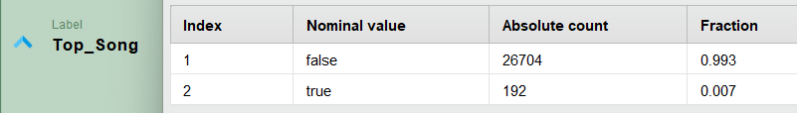
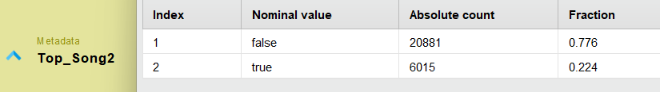
Comparison Top Song Label by Popularity and Minimum Charts Position

Slide 33
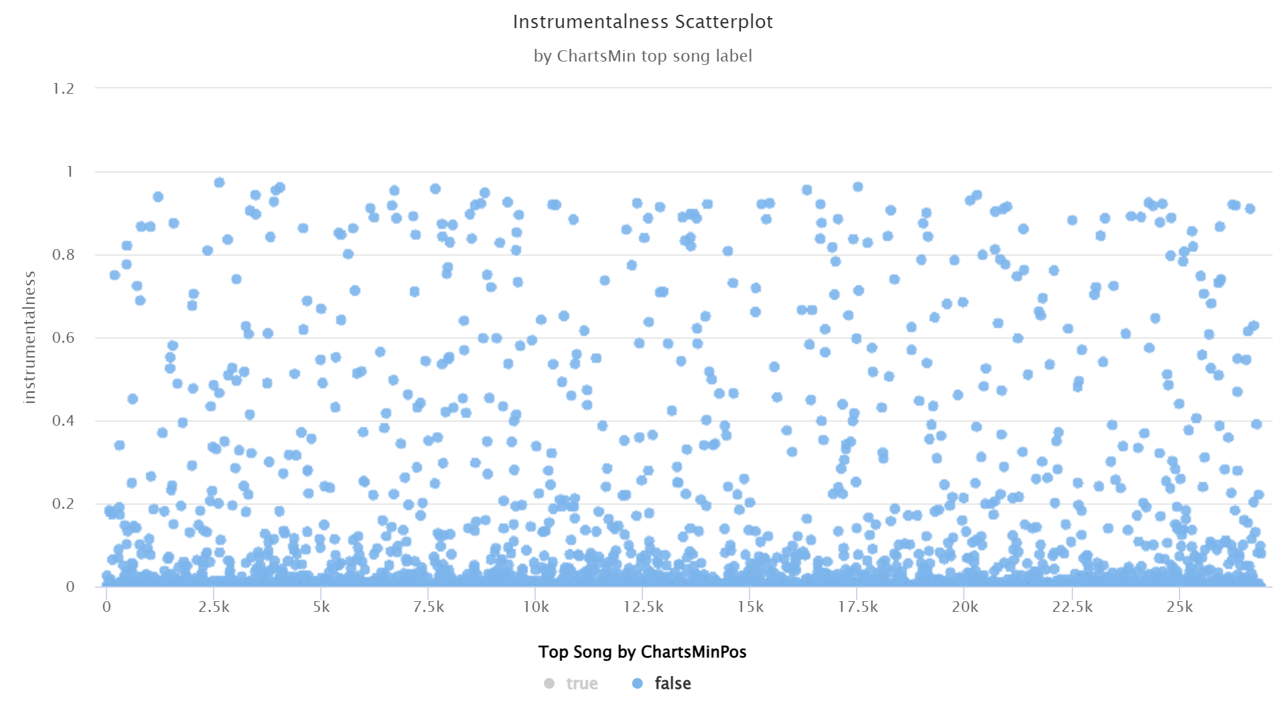
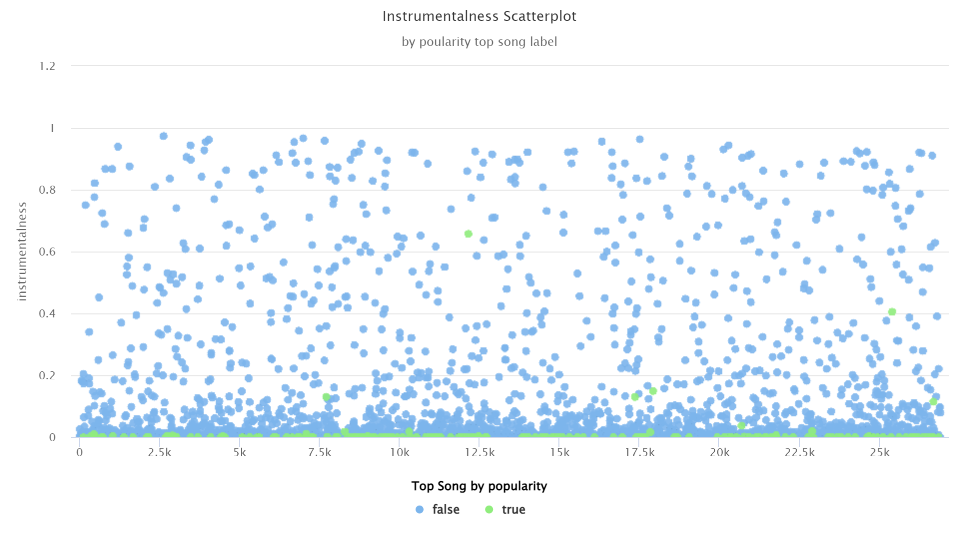
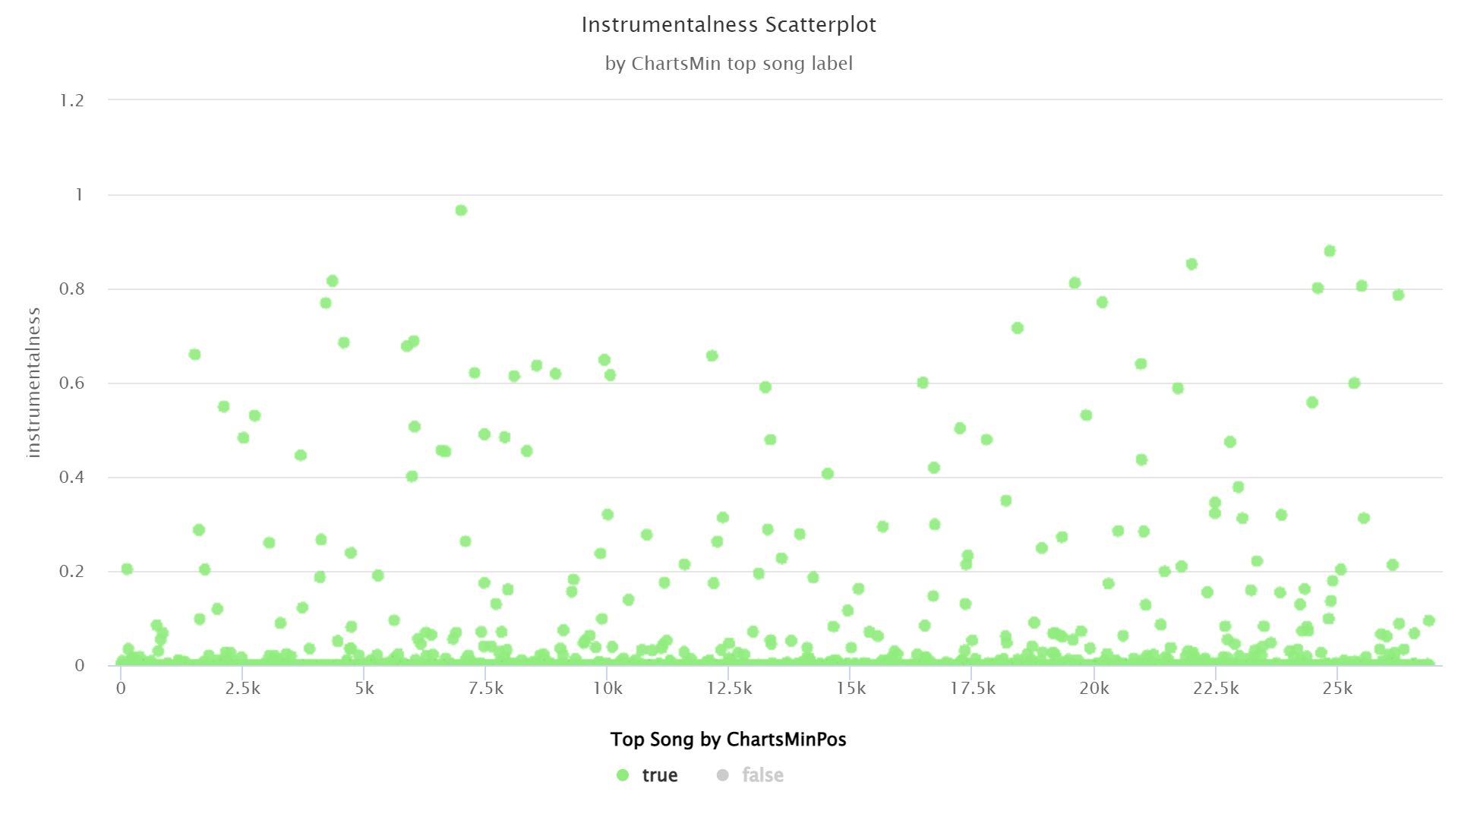

Slide 34
Modeling

Slide 35
Chosen Models
XGBoost
KNN
SVM
Random Forest
Gradient Boosted Trees
Logistic Regression

Slide 36
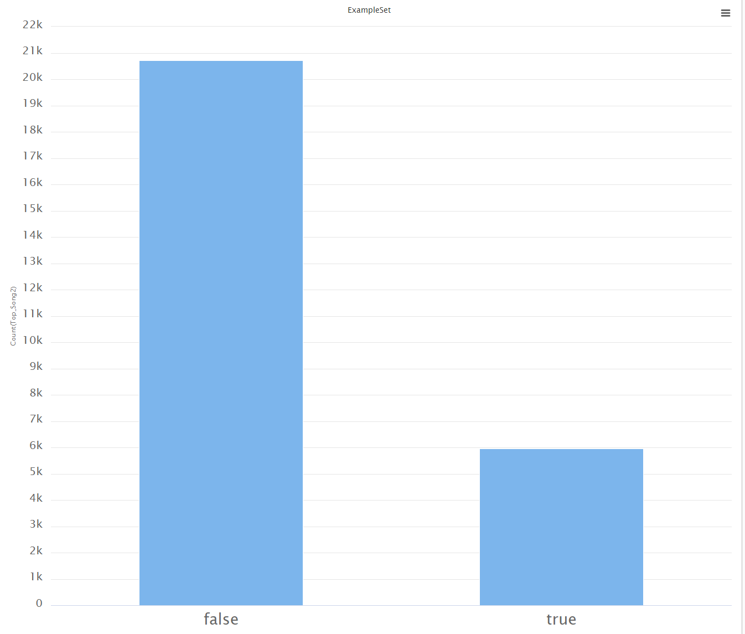
FIRST Iteration Unbalanced

Slide 37
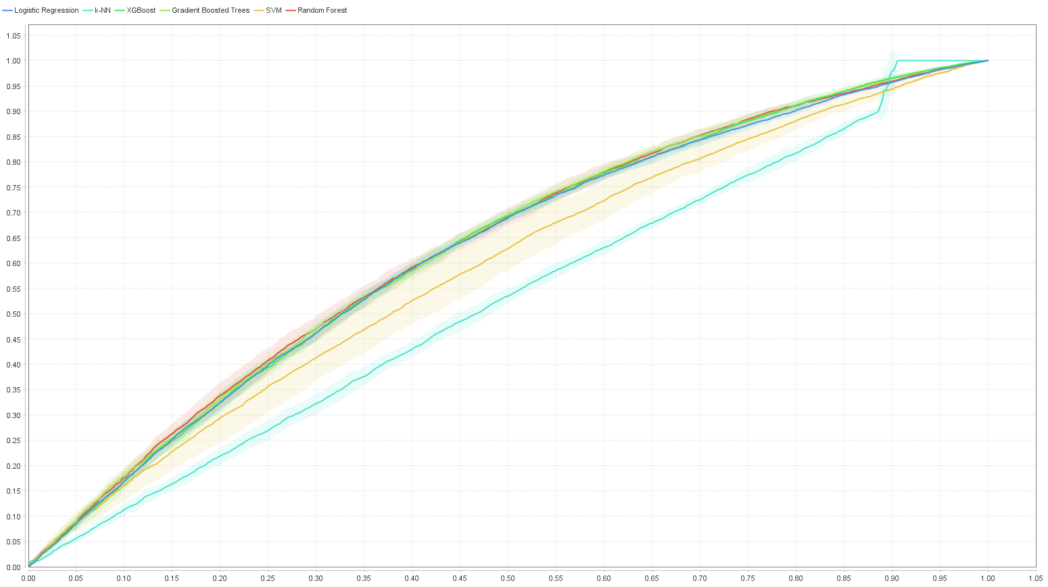
First Iteration ROC unbalanced

Slide 38
First Iteration unbalanced

Slide 39
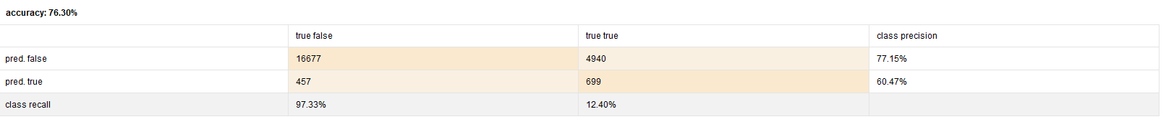
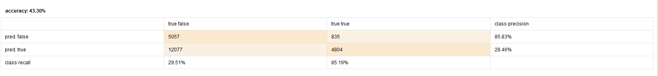
Performance First Iteration unbalanced
XGboost
Gradient Boosted Tree

Slide 40
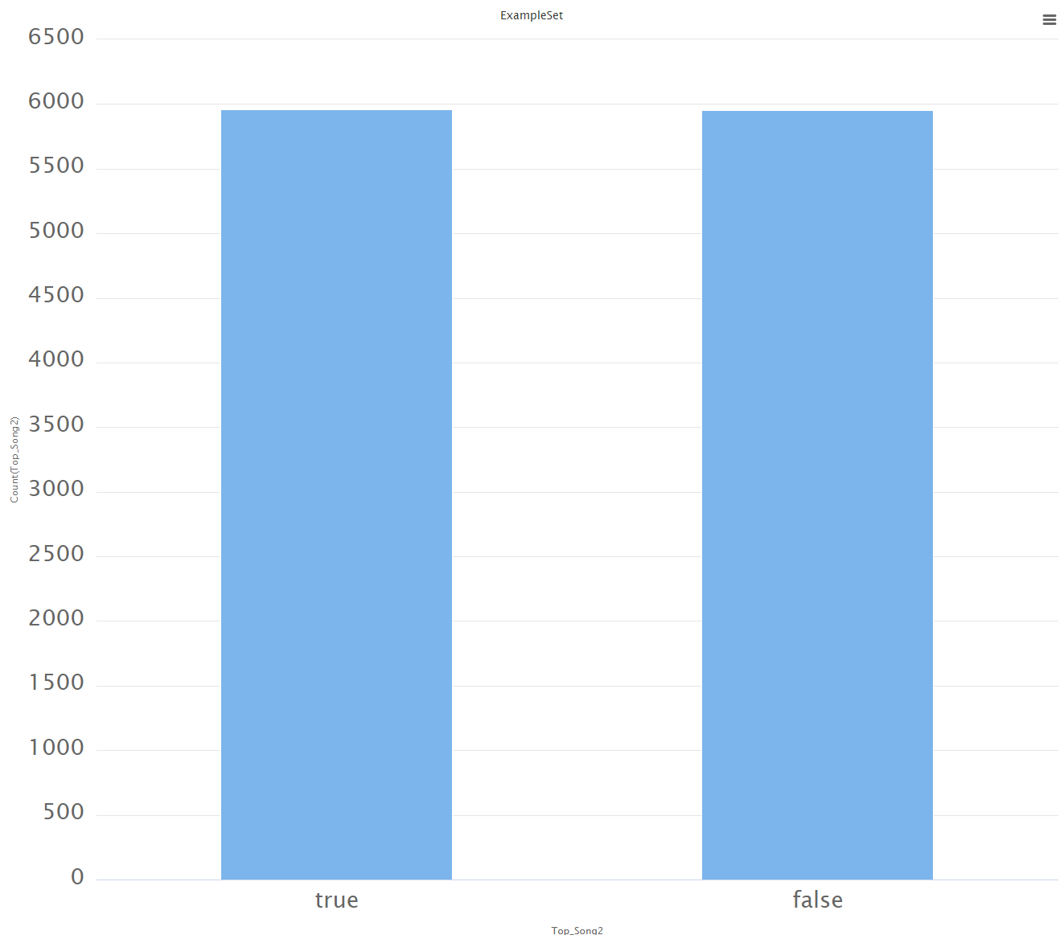
FIRST Iteration Balanced

Slide 41
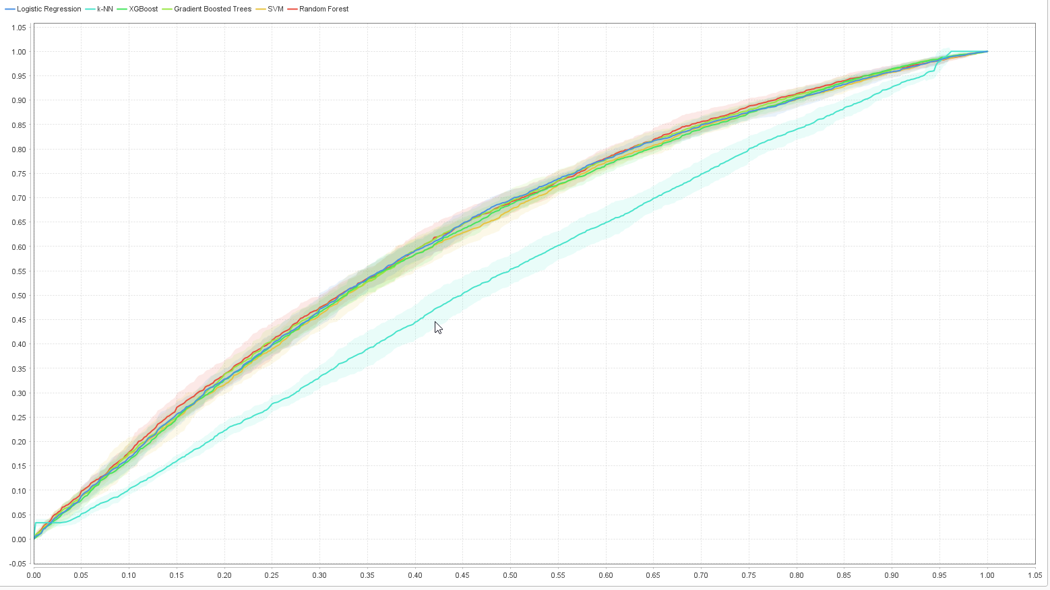
First Iteration ROC Balanced

Slide 42
First Iteration Balanced

Slide 43
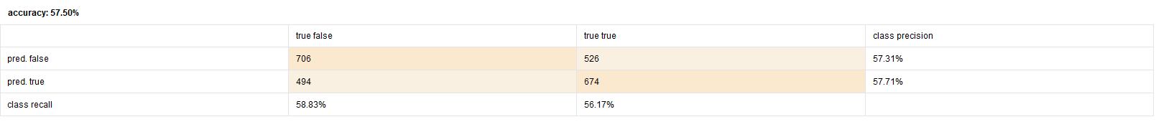
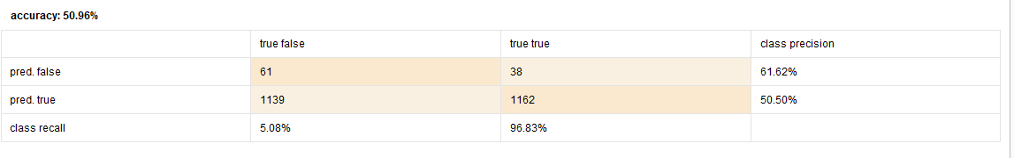
First Iteration Balanced
XGboost
Gradient Boosted Tree

Slide 44
The first iteration shows that we need to enrich our data
Two new data sets are needed to get following information:
artists.csv → Metrics e.g. popularity and followers of the artist
dict_artists.json → Recommendation of artists
JSON data could not processed via RapidMiner, so we need to transform it in Phyton. The generated data can be now used with RapidMiner.

Slide 45
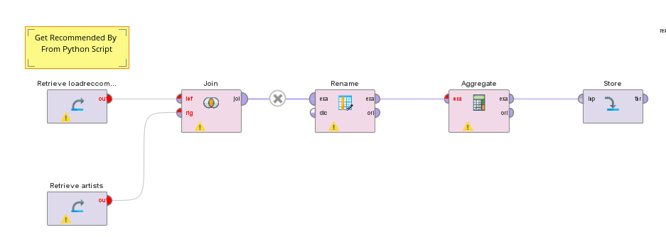
Preparation process for second iteration

Slide 46
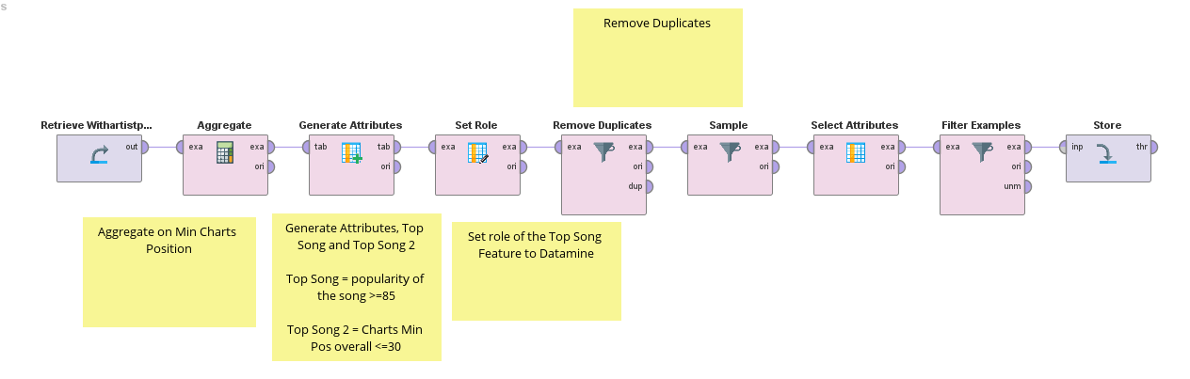
Preparation process for second iteration

Slide 47
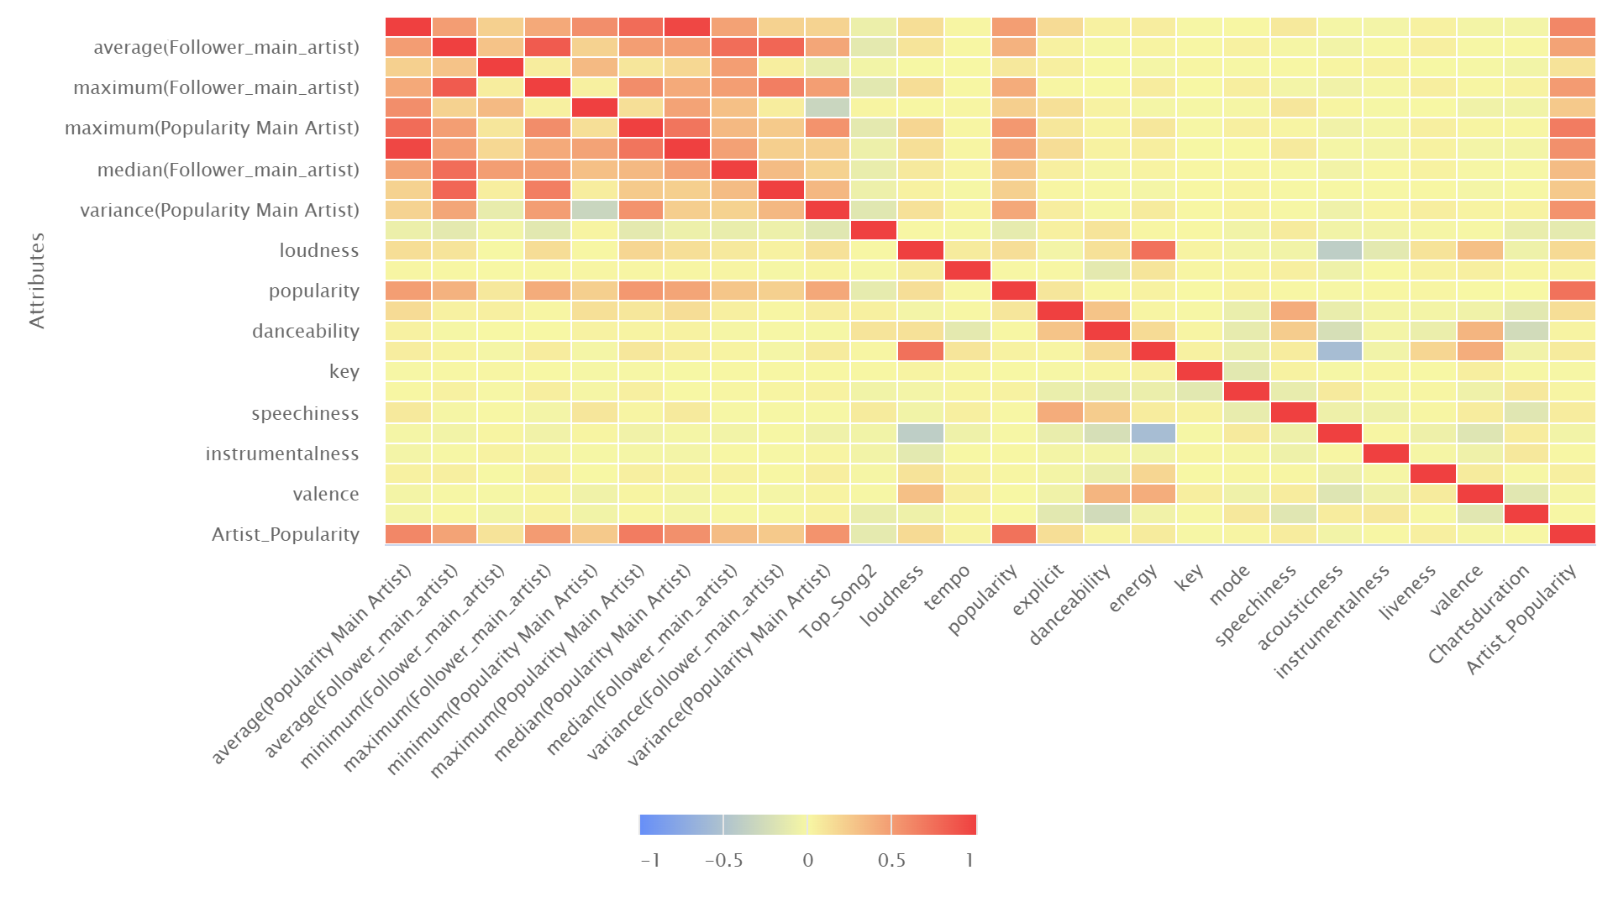

Slide 48
Second Iteration

Slide 49
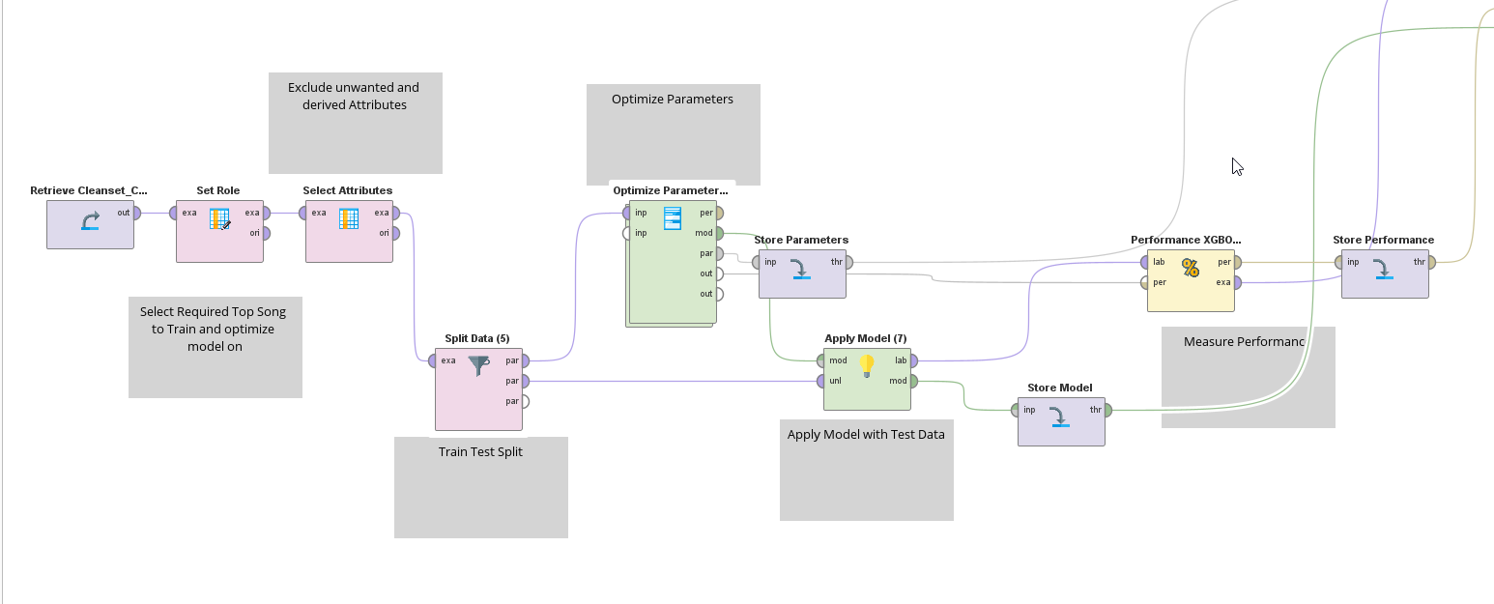
Second Iteration Model Template – Parameter Tuning

Slide 50
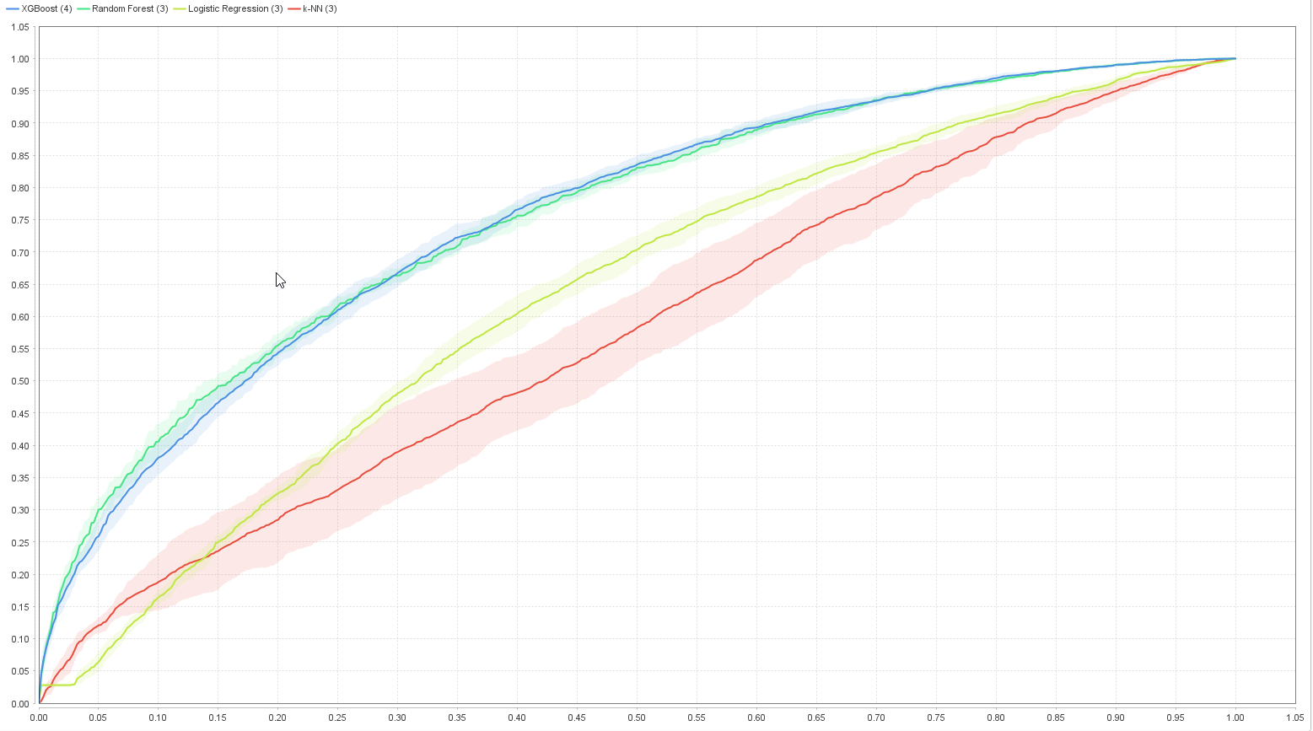
Second Iteration ROC After Training

Slide 51
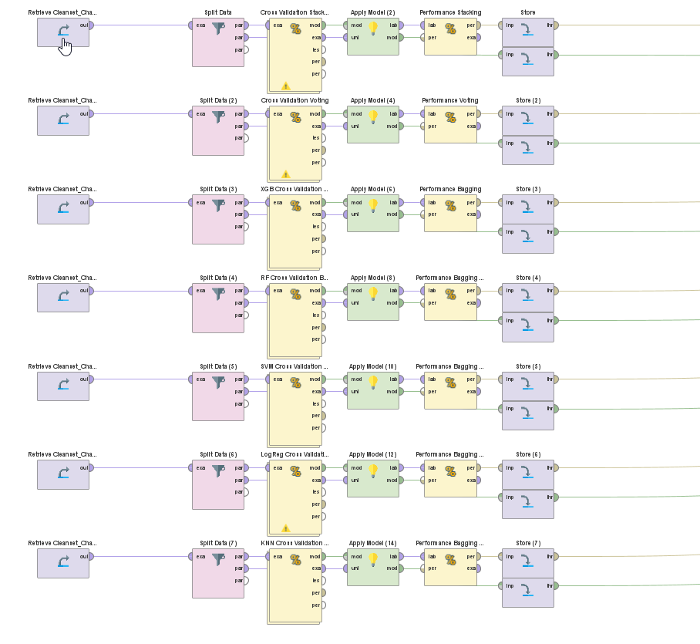
Second Iteration Model Template – Ensembles

Slide 52
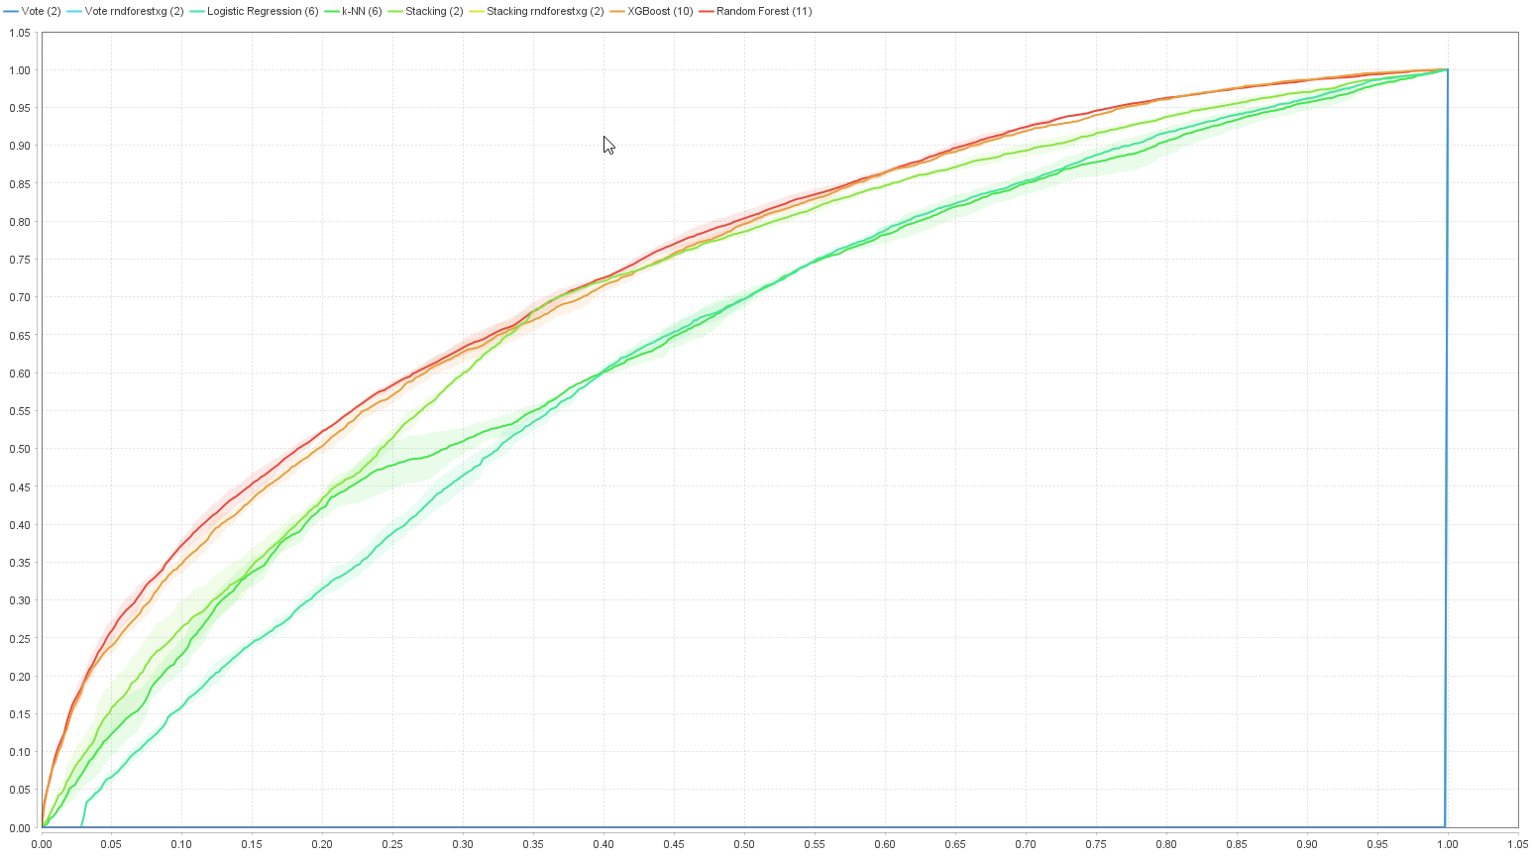
Second Iteration ROC after Ensemble

Slide 53
Second Iteration Balanced Model Results

Slide 55
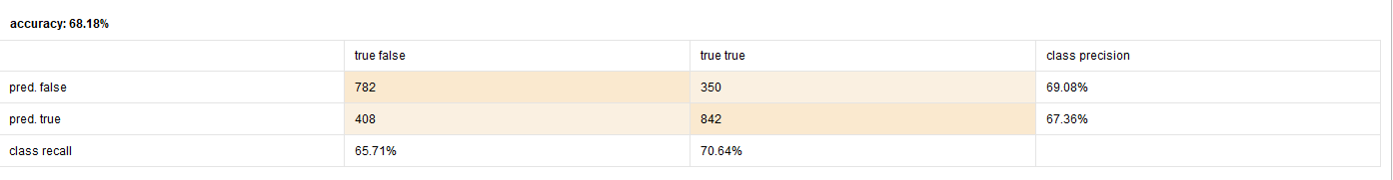
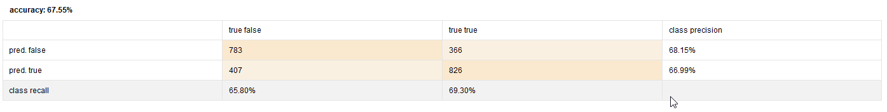
Final Chosen Models
Random Forest
Stacking All Models

Slide 56
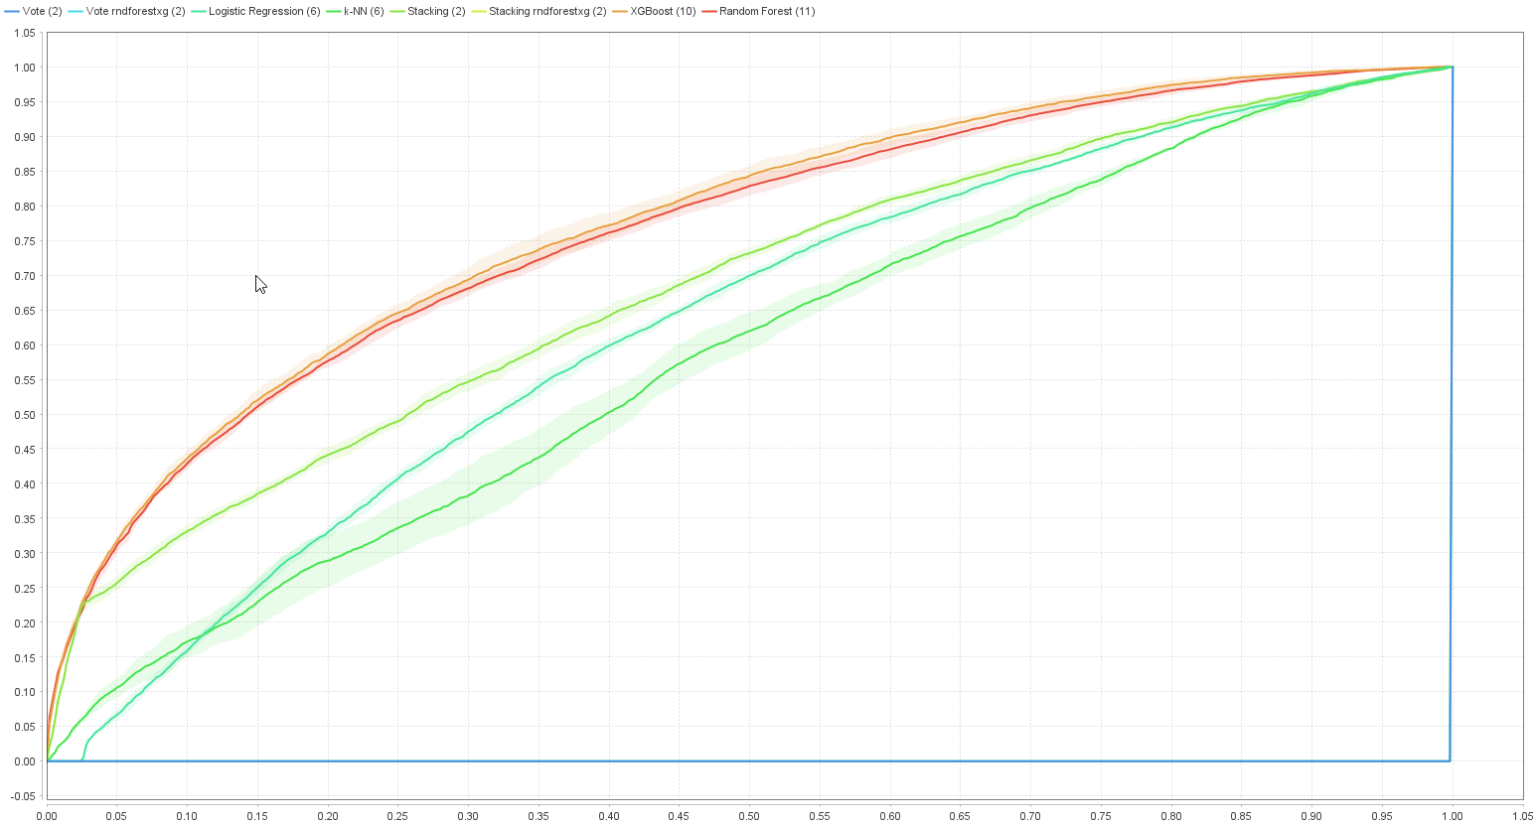
Second Iteration Modeling Result – ROC unbalanced

Slide 57
FP GROWTH

Slide 58
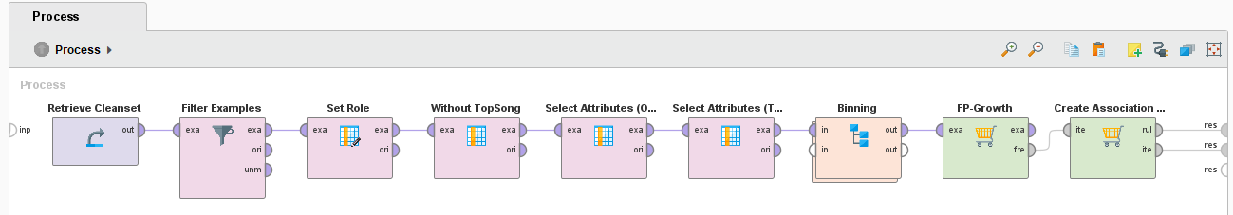
Modeling: FP Growth – Process
Frequent Item Combinations
Result: „If song has feature X then it also has feature Y“
Requirement: Need to convert features from quantitave to categorial
Bias: No direct comparison between „Top Song“ & „No Top Song“

Slide 59
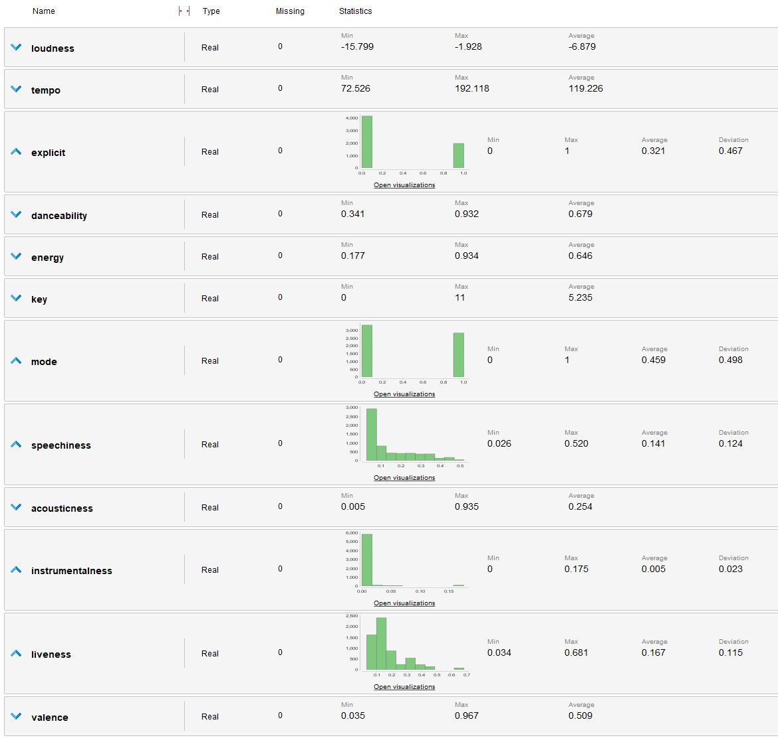
Modeling: FP Growth – Imbalanced Attributes

Slide 60
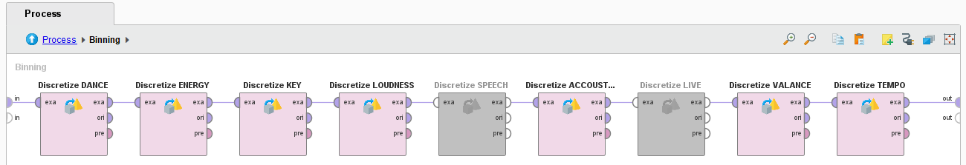
Modeling: FP Growth –Binning
Customized Binning
Advantage: Range adapted to the scale & classes directly readable
Disadvantage: High manual effort – to be adjusted with every change

Slide 61

Modeling: FP Growth – Binning Result

Slide 62

Modeling: FP Growth – Result “TRUE”

Slide 63

Modeling: FP Growth – Result “FALSE”

Slide 64
Region Analysis

Slide 65

Modeling: REGION – DATA sets

Slide 66

Modeling: REGION – Process General

Slide 67

Modeling: REGION – Validation
Operator: Random Forest as its results were most promising in previous models
Reliability highly depends on available datasets per region
Room for further Investigations

Slide 68
Modeling: REGION – Result

Slide 69
Reflection

Slide 70
Reflection
Genre: We did not differentiate between different genres, an improvement could be to research top songs in different genres separately (e.g pop, rock, rap,…)
Our datasets where not sufficient for those kind of research. There where too special and too much genres (e.g Greek pop, Japanese R&B,..). But those Genres could be classified in similar groups, means of course a lot of effort and time.
Time: We could also made a time series analysis. In our model we do not take into account if there where also trends during the different years or decades. Also seasonal differences could be interesting (e.g. Christmas songs)*
We find out that the popularity factor increases, if artists are recommended by popular artists, but we still don´t know how the factor of recommendations are built. We could investigate here more. What are the factors that a song, is listed as a recommended song? What is needed, that a artist will be recommended?
Notes:
* Reference use case which considers the time factor: https://www.stat.cmu.edu/capstoneresearch/spring2020/315files/team3.html

Slide 71

Reflection
We could also investigate more into clustering in different countries.
We started to do that and clustered charts in different regions and saw differences between different countries but overall the results were not really good. We would need more data to have a reliable model.

Slide 72

Reflection Possible improvements in current model setting
Sampling: We joined 2 different data sets for sampling. Therefore we could just work with 26k songs and only 6k of them were top songs.
Net loss data quality → 600k to 26k to 12k after sampling
General pain point: It took really long to run our models (up to 1 day), so to see the result of an adjustment, take really long.
We did not check for overfitting.

Slide 73

Reflection Apply MODEL on real World data

Slide 74

Reflection – Apply MODEL on real World data
Model is good at identifying non-top songs but not good at identifying top songs

Slide 75
conclusion
It is important to note that predicting music popularity/top song is not an exact science, and there are many factors that can influence the success of a song, such as marketing, promotion, and timing. Nonetheless, by using data and machine learning algorithms, it is possible to identify songs that have a higher probability of becoming popular/top song, and to make informed decisions based on that prediction.
When taking the results of the second iteration into account, it can be stated, that song attributes are secondary, while the main factor to get a top song seems to be the popularity metric and follower count.
However, looking to our real world data, we would need more data and should train the model on a new dataset.

Slide 76
Backup

Slide 77

ARTISTS Data

Slide 78

ARTISTS Data

Slide 80
Data Exploration – Comparision
https://www.stat.cmu.edu/capstoneresearch/spring2020/315files/team3.html

Slide 81

Feature Selection Results

